Slide 1
HTML Styles
Presented by: MANal Asghar

Slide 2
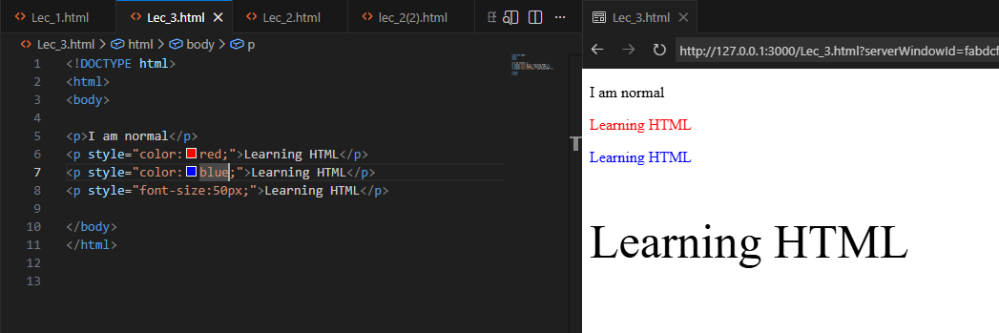
HTML Styles
The HTML style attribute is used to add styles to an element, such as color, font, size, and more.

Slide 3
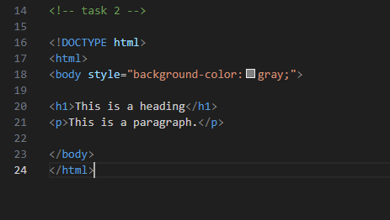

Background Color
The CSS background-color property defines the background color for an HTML element.

Slide 4
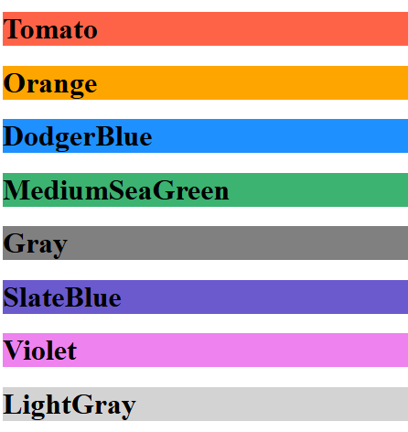
HTML Colors
HTML colors are specified with predefined color names, or with RGB, HEX, HSL, RGBA, or HSLA values.

Slide 5
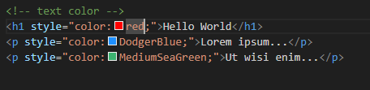

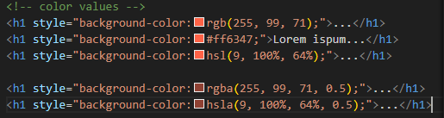
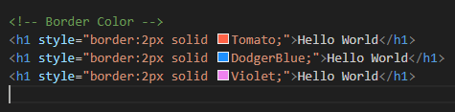
HTML Colors
Text Color:
Background Color
Border Color
Color Values

Slide 6
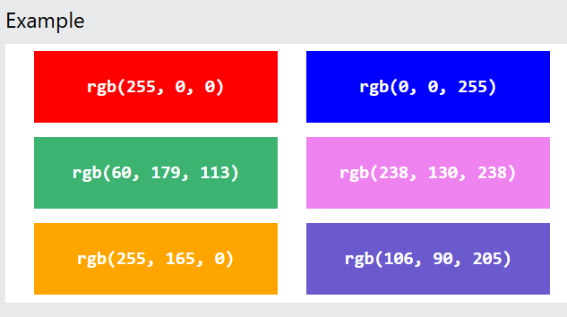
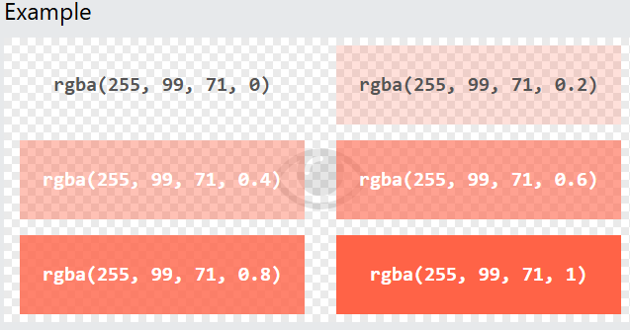
HTML Colors
RGB Color Values : rgb(red, green, blue)
RGBA Color Values: rgba(red, green, blue, alpha) The alpha parameter is a number between 0.0 (fully transparent) and 1.0 (not transparent at all):

Slide 7
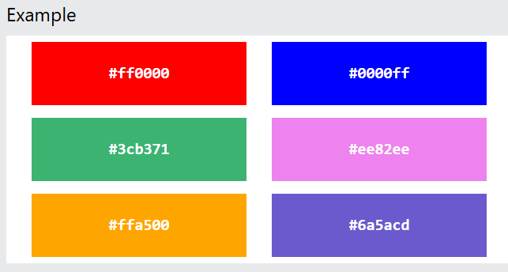
HTML HEX Colors
#rrggbb
Where rr (red), gg (green) and bb (blue) are hexadecimal values between 00 and ff (same as decimal 0-255).
For example, #ff0000 is displayed as red, because red is set to its highest value (ff), and the other two (green and blue) are set to 00.

Slide 8


HTML Links
Hyperlinks: HTML links are hyperlinks. You can click on a link and jump to another document. When you move the mouse over a link, the mouse arrow will turn into a little hand.
HTML Links - The target Attribute
By default, the linked page will be displayed in the current browser window. To change this, you must specify another target for the link. The target attribute specifies where to open the linked document. The target attribute can have one of the following values:
_self - Default. Opens the document in the same window/tab as it was clicked
_blank - Opens the document in a new window or tab
_parent - Opens the document in the parent frame
_top - Opens the document in the full body of the window

Slide 9
Absolute URLs vs. Relative URLs
Both examples above are using an absolute URL (a full web address) in the href attribute.
A local link (a link to a page within the same website) is specified with a relative URL (without the "https://www" part):

Slide 10
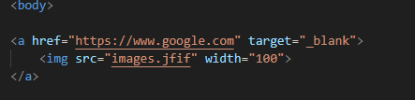

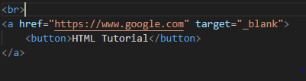
Use an Image as a Link
Link to an Email Address
Button as a Link

Slide 11
Introduction to CSS:
CSS stands for Cascading Style Sheets.
Cascading Style Sheets (CSS) is used to format the layout of a webpage.
With CSS, you can control the color, font, the size of text, the spacing between elements, how elements are positioned and laid out, what background images or background colors are to be used, different displays for different devices and screen sizes, and much more

Slide 12
Types of CSS
There are three main types of CSS:
Inline CSS – Style is applied directly to an HTML element using the style attribute.
Internal CSS – Style is written inside a <style> tag in the <head> section of the HTML document.
External CSS – Style is written in a separate .css file and linked to the HTML document using a <link> tag

Slide 13
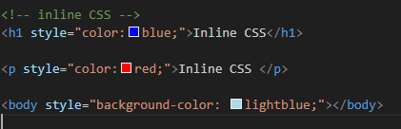
Inline CSS
An inline CSS is used to apply a unique style to a single HTML element.
An inline CSS uses the style attribute of an HTML element.
The following example sets the text color of the <h1> element to blue, and the text color of the <p> element to red: and change background color using inline CSS

Slide 14
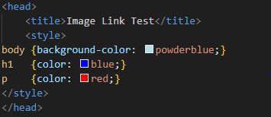
Internal CSS
An internal CSS is used to define a style for a single HTML page.
An internal CSS is defined in the <head> section of an HTML page, within a <style> element.
The following example sets the text color of ALL the <h1> elements (on that page) to blue, and the text color of ALL the <p> elements to red. In addition, the page will be displayed with a "powderblue" background color:

Slide 15

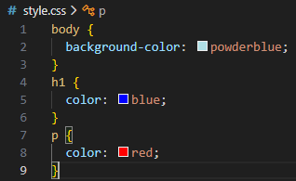
External CSS
An external style sheet is used to define the style for many HTML pages.
To use an external style sheet, add a link to it in the <head> section of each HTML page:

Slide 16
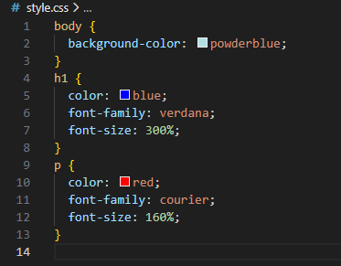
CSS Colors, Fonts and Sizes
We will demonstrate some commonly used CSS properties. You will learn more about them later.
The CSS color property defines the text color to be used.
The CSS font-family property defines the font to be used.
The CSS font-size property defines the text size to be used.

Slide 17

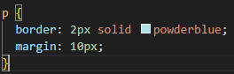
CSS Padding
The CSS padding property defines a padding (space) between the text and the border.
CSS Margin
The CSS margin property defines a margin (space) outside the border.

Slide 18
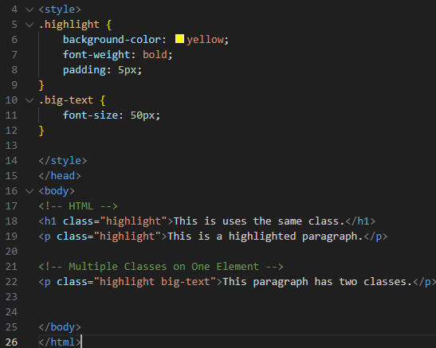
HTML class Attribute
The HTML class attribute is used to specify a class for an HTML element.
Multiple HTML elements can share the same class.

Slide 19
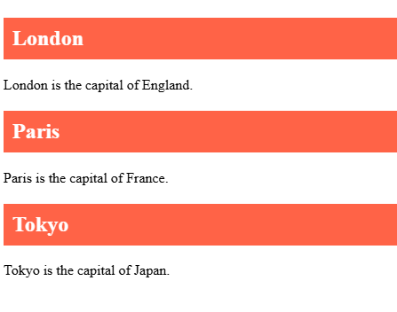
Task: Create an HTML page with at least three headings, and use a CSS class to give all headings a colored background and white text.

Slide 20
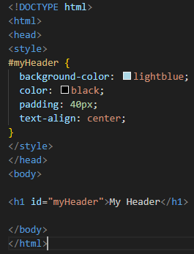
HTML id Attribute
The id attribute specifies a unique id for an HTML element. The value of the id attribute must be unique within the HTML document.
The id attribute is used to point to a specific style declaration in a style sheet. It is also used by JavaScript to access and manipulate the element with the specific id.
The syntax for id is: write a hash character (#), followed by an id name. Then, define the CSS properties within curly braces {}.
In the following example we have an <h1> element that points to the id name "myHeader". This <h1> element will be styled according to the #myHeader style definition in the head section:

